Slide 1

Presentation and Design Choices
Developed by:
Alessandro Pasquetto
Lorenzo Orlandi
Gabriele Pedesini
Stefano Molteni

Slide 2
MVc Pattern
Server | Client
Model Contains most of the game logic and is responsible for maintaining the state and information related to the various ongoing matches. Controller Handles the orchestration of the different game phases, and manages the requests and responses of the various users. | View Whether it's a TUI or a GUI, it contains the logic for creating the user interface and managing all possible user interactions. Model A more lightweight model whose purpose is to maintain a consistent local state on the client side, in order to minimize the amount of data exchanged with the server.
On both the server and client sides, dedicated classes are implemented to manage communication using Socket and RMI protocols.

Slide 3
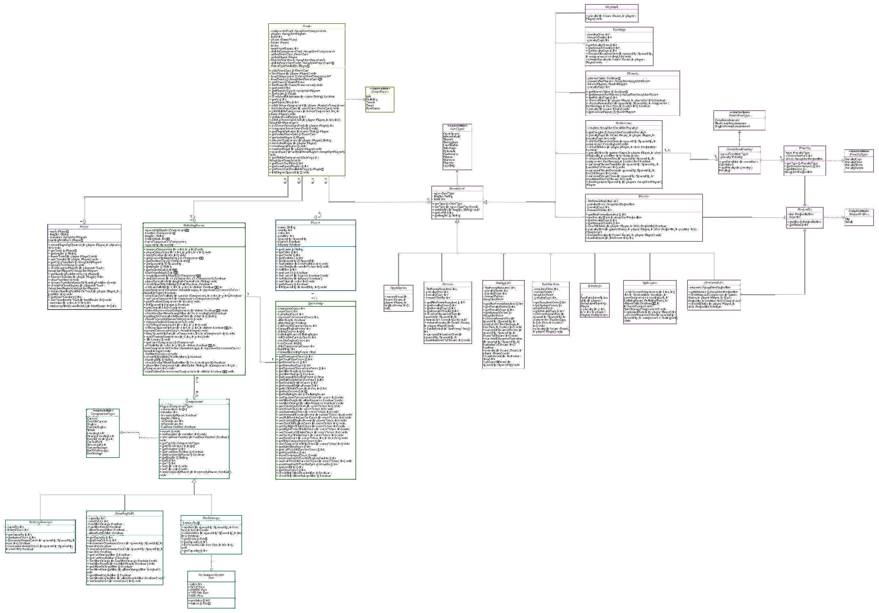
Game
Spaceship
Player
Components
Board
Events

Slide 4
Implemented Functionalities
Rules
✅ Basic rules
✅ Complete rules
Connection
✅ Socket
✅ RMI
User Interface
✅ TUI
✅ GUI
Additional Functionalities
✅ Demo travel
✅ Multiple games
✅ Resilience
❌ Persistence

Slide 5
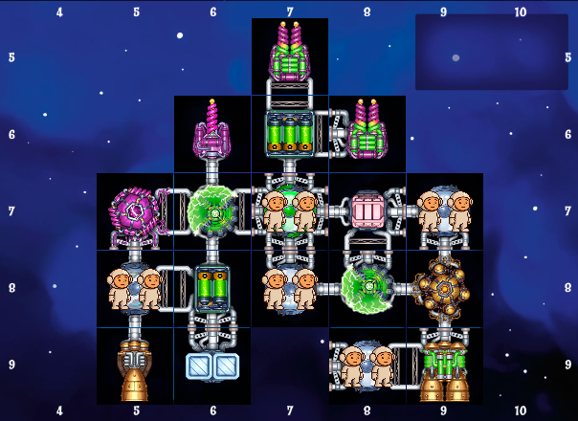
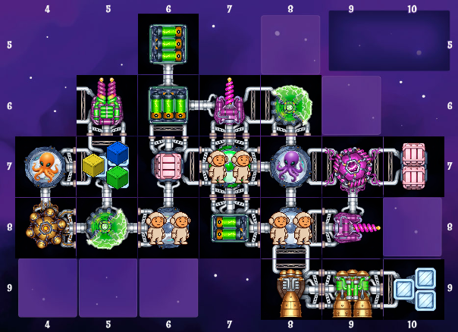
DEMO TRAVEL
To manage the distinction between demo travels and level 2 travels, we introduced a level attribute in the Game class.
This attribute allows us to define the correct behaviour to apply in various gameplay situations where there is a functional difference between the two types of games.
Demo travel
Level 2 travel

Slide 6
MULTIPLE GAMES
To support the coexistence of multiple games running simultaneously on the same server machine, we introduced a helper class called GameManagerMaps. This class contains a map of GameManager instances, each associated with a specific game ID as the key.
Each game is therefore linked to its own GameManager, which is responsible for storing useful information about the game.
Every communication between client and server is labelled with the ID of the game the user is currently participating in. This enables the system to forward the message to the correct GameManager.
Server
Client
Message (id=1)
Game 1
Message (id=2)
Client
Game 2

Slide 7
RESILIENCE (1)
A ThreadPinger sends a ping every second to all connected clients (both via Socket and RMI):
Socket: A client is considered disconnected if it doesn’t respond before the next ping.
RMI: A client is considered disconnected if a RemoteException is thrown during the ping.
Server
Client
ping
pong

Slide 8
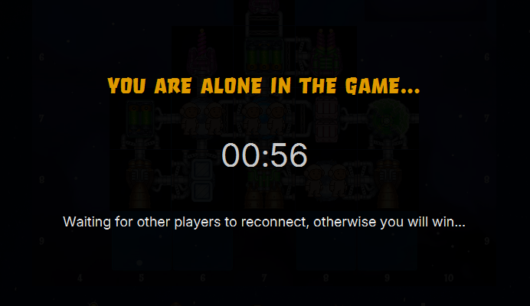
RESILIENCE (2)
Disconnection is handled differently based on the game phase:
Lobby Phase
The disconnected player is removed from the lobby list.
Game Phase
Player is moved from the active players list to a disconnected list.
If only one active player remains, the game enters freeze mode.
Disconnected players are excluded from "ready" checks, and the game proceeds with automatic decisions for them.
Freeze mode

Slide 9
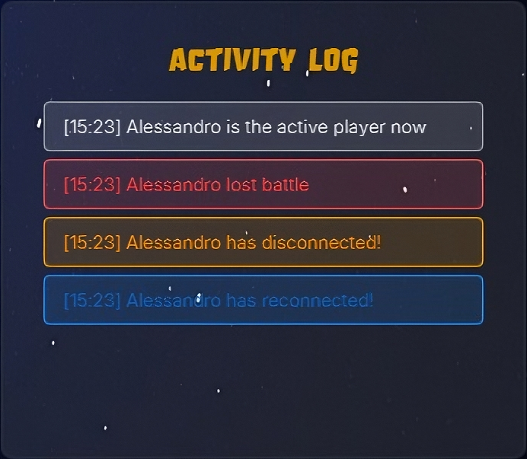
RESILIENCE (3)
Reconnection
If a player reconnects during a game, they are restored to the active list.
If they were part of an ongoing event, a specific reconnection handler is invoked (each event card provides one), ensuring the player can resume participation, including re-sending pending questions.

